Slide 1

Revature Meet & Greet
Advancing Talent and Technology
“The most reliable way to predict the future is to create it” – Abraham Lincoln

Slide 2

What are Meet & Greets?
Meet Client Leaders and Potential Teams.
A way for you to ask questions about the client(s) and team(s).
Platform to ask directly about technologies and impacts teams are making in technology.
Aimed at preparing you for interviews with clients.
Meet & Greet

Slide 3
Introducing Yourself
State your Name, Region, Background, Fun Fact
Please be Brief (less than 60 seconds)

Slide 4
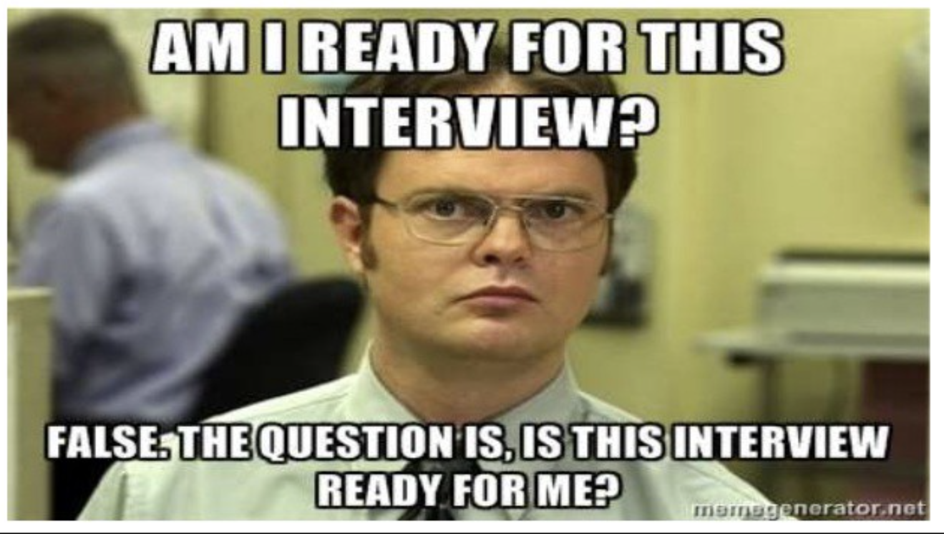
Basic Do’s and Don’ts
DO’s
DON’Ts
Be polite and professional
Prepare a few relevant questions
Ask questions & Participate
Be on video with appropriate lighting
Be on mute unless asking or answering questions
Wear appropriate attire
Be positive
Pay Attention
Take Notes
Ask Revature related questions
PTO, Pay, Relocation, Benefits
How many positions are there
Not all will know
Leave the area while you're on video during the M&G
Drink or Eat During M&G
Take another Call during M&G
Meet & Greet?
Meet & Greet

Slide 5
Sample Questions
When you are ready with your question, please use the Raise Hand feature in Teams and wait to be called upon then Introduce yourself (just your name) then proceed with your question.
We are in our ## week of training while we are learning XYZ, can you tell us what to prepare for the most during our training?
Can you tell us more about your team size?
Are your teams in Daily Stand Ups? If so, how do those look?
Do you participate in Sprints? If so, what is the average of each sprint?
We are working on our certifications; can you tell us more about your cloud environment and what we can expect as a new team member?
I read a bit about ABC Business Unit and was curious about XYZ impact on the team, can you expand on that?
What can best prepare us between if we are selected to join and being onboarded? What would you recommend us looking into?
What advice would you give to someone new to the Team like myself, in order to be successful?
Can you share any tips that you feel we should adopt on day one?
What sort of project documentation exists?
Where do you see the company grow in the next 5 years and is there anything we can do to align ourselves for that?

Slide 6
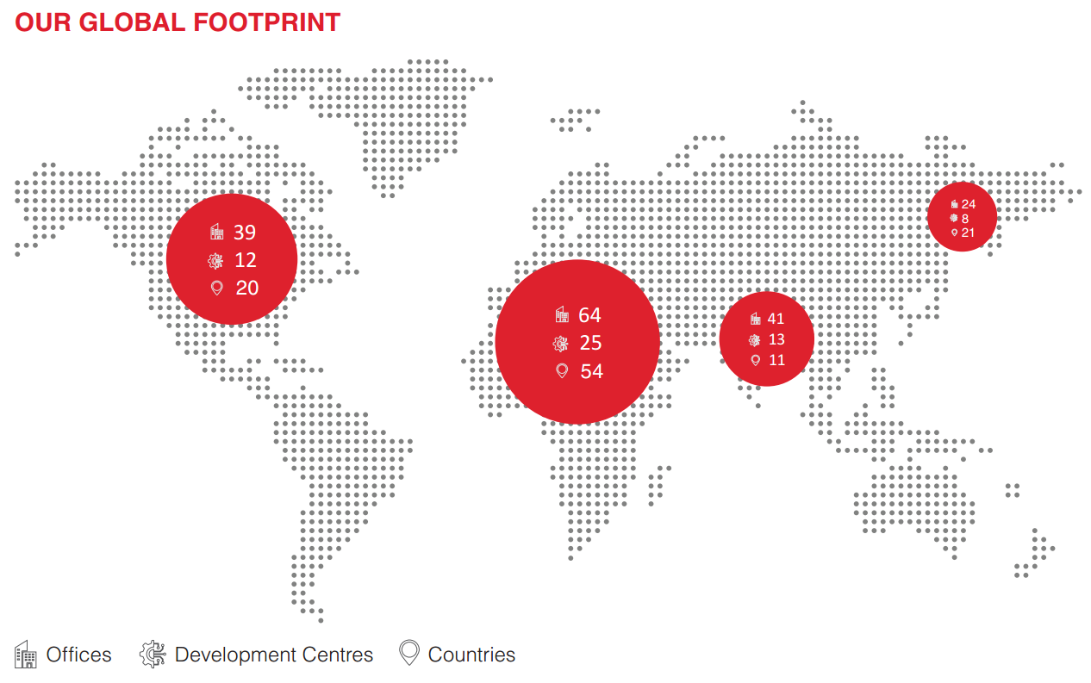
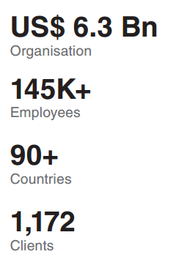
Global Company…

Slide 7
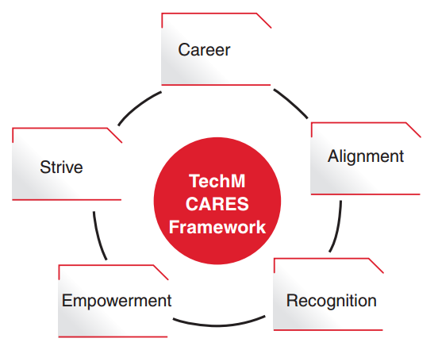
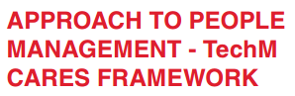

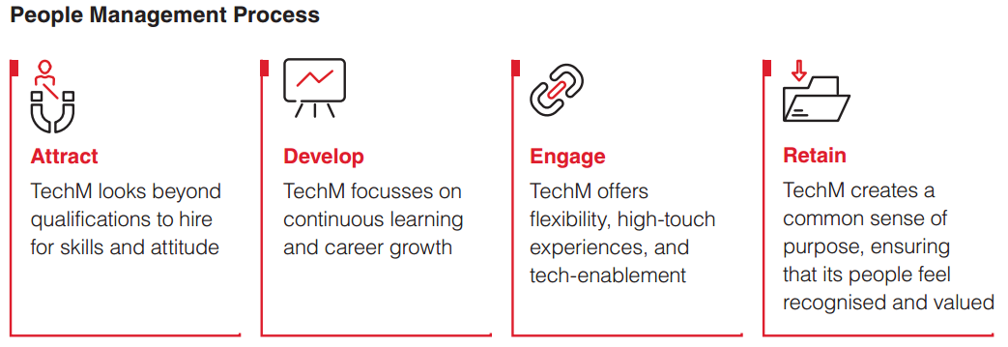
Why TechM

Slide 8

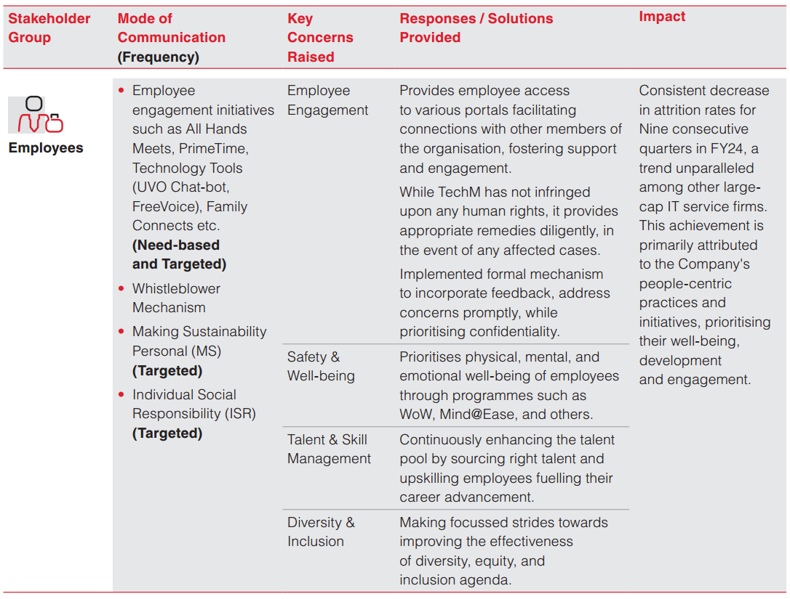

Slide 9

Offerings / Service lines
Serving Industries
TELECOMMUNICATIONS
MANUFACTURING
BANKING, FINANCIAL SERVICES AND INSURANCE (BFSI)
TECHNOLOGY, MEDIA AND
ENTERTAINMENT
HEALTH AND LIFESCIENCES
RETAIL AND OTHERS
Service lines:
NEXT GENERATION SERVICES: Offer diverse solutions including Data and Analytics, AI and GenAI, Cybersecurity and Risk Management and emerging technologies like Metaverse and Blockchain.
DIGITAL ENTERPRISE APPLICATIONS: We are a Digital Enterprise Applications powerhouse, empowered by the combined competencies from SAP, Oracle, Salesforce, Microsoft, ServiceNow
NETWORK SERVICES: The communication industry is being revolutionised by innovations in 5G technology, hyper-automation, artificial intelligence, machine learning, and private and public clouds.
CLOUD INFRASTRUCTURE SERVICES: Our services cover the entire IT infrastructure stack and support technologies, enabling digital transformation.
DIGITAL ENGINEERING SERVICES: TechM is a global leader in engineering services with over three decades of experience and competencies across 10+ industry verticals.
APPLICATION DEVELOPMENT MAINTENANCE SERVICES (ADMS): TechM’s Application Services division stands at the forefront of digital transformation, offering tailored solutions to meet the diverse needs of businesses across industries.

Slide 10

Q & A
Thank you for joining, we know you are just getting started!

Slide 11
Thank You
Gabriel S Kumar
(gabriels@revature.com)
Senior Delivery Manager
Terry Ahmed
(terry@revature.com)
Account Manager
For More Information
Please feel free to reach –
Private and Confidential: For Internal Use Only

